Slide 1
Project 2- The Hub
Ursula Wilborn

Slide 2
Elevator Pitch
Do you own tons of books?
Are you a student who needs to book for class but can’t find a copy?
If the answer is yes, then this app for you!
WHY?
The Hub is a fast, friendly, and convenient way to donate or request a book and have it shipped to you within days!

Slide 3
Concept
Description
This application is ideal for book owners and users who need an app that allows them to either donate a book or request a book for free.
An application that accepts a user sign-up and log-in and allows the user to either donate a book or request a book.

Slide 4
Concept
Motivation for development?
Bound Books are becoming obsolete.
African American books are hard to find.
Controversial books are being removed from school curriculums and thus, being removed from school libraries.
User story
A portable way/method for students to request hard to find books that are not readily available in the local library for free and for the general public to donate books for others,

Slide 5
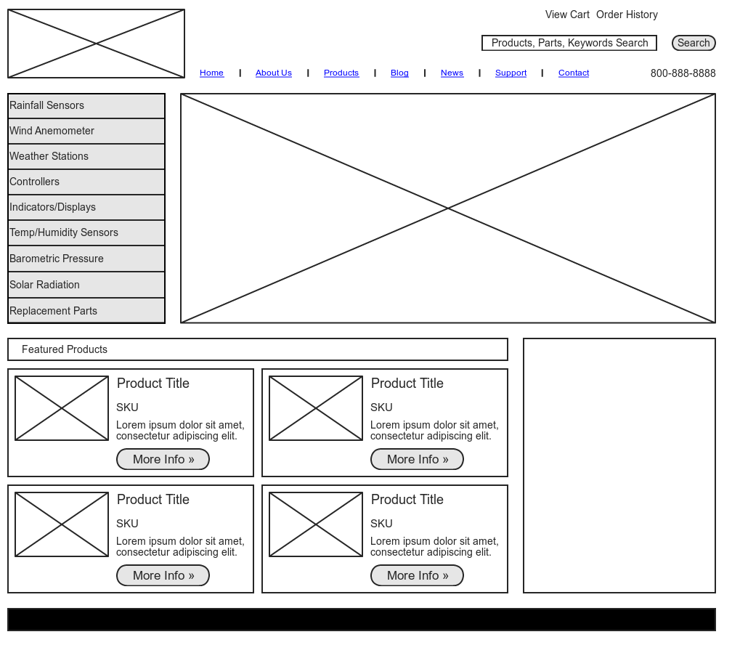
Main/Homepage
Logo and Title
The Hub
Login
Store
Menu:
Account Info
View Exchanges
Add Exchanges
Delete Exchanges
View Book List
View Schools List
Exchange
Author Pic & Bio
Featured Products:
Book Club
Literary Critics
My Literary Tribe
Book Store
Book of the Month (Pic)

Slide 6
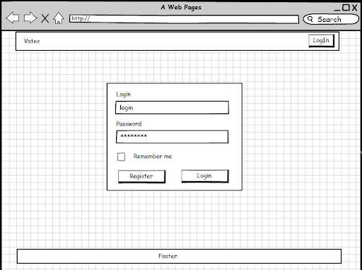
Login Page

Slide 7
Database- Tables
User Registration/School Registration
Create Exchange by Entering User Information
Receives Exchange Number &
View List of Possible exchanges & select exchange Number
Create a Shipping Manifest
User Login

Slide 8
Donate- Process
Donate Link (landing)
Fill Out Form
Process Form Input
Change Page (Route)
Thank You & Create a Shipping Manifest
Change Page (Route)
Link in Landing.handlebars only if the user is logged-in
homeRoute
donate.handlebars
donate.js
apiRoute
logout.handlebars

Slide 9
Database- Tables
Books
ID (PK)
Author First Name
User Data
ID (PK)
Exchange Project
ID
First Name
Last Name
School_id
Grade
Email
Title
Qty of Books Needed
School Data
ID (PK)
Author Last name
School Name
School Level
Book_id
Cost
Genre
foreign key fk1(school_id) references school(id)
foreign key fk2(user_id) references user(id)
User_id
foreign key fk3(book_id) references book(id)
Stock Qty
Password

